Slide 1
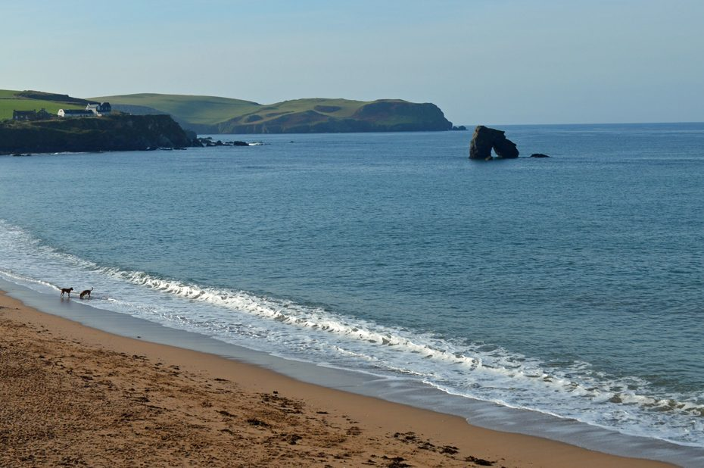
PE:
As well-rounded, active citizens, our children will feel a sense of belonging by immersing themselves in a wide range of physical activities. This term, our sessions will be guided by the Premier Sports. They will take place on a Wednesday afternoon.
Science:
As scientists, the Year 1s will be learning all about everyday materials. They will be developing their understanding of objects and the materials from which they are made. They will classify and sort items into categories such as wood, plastic, glass, metal, fabric and paper. Once comfortable with the term ‘materials’, they will deepen their understanding by describing the properties of different materials and make simple comparisons.
Maths:
As Mathematicians, the Year 1s will be deepening their understanding of number by exploring addition and subtraction within 10. They will be introduced to the part-whole model and will explore different ways of representing addition and number facts. The children will also read, interpret and write +, - and = symbols to write simple number sentences.
Art & Design: As Artists, we will be exploring the work of the local artist Brian Pollard. We will analyse his work and consider how he uses shape and colour within his paintings. Initially we will make simple sketches based on what we can see within images. We will than use local landscape and seascapes to inspires us to draw and paint in the style of Brian Pollard.
Design & Technology:
As Designers, we will be learning about different joining techniques. We will explore different materials and consider how best to join them. Joining techniques will include gluing, stapling, safety pins, pinning and sewing.
Computing:
During our computing lessons, we will be focusing on the theme, ‘Technology Around Us.’ We will ponder what we already know about technology and think about how we use it within the classroom. We will ask questions about how technology can help us and explore using simple technology. This will include, knowing how to turn on a computer, open a program, use a mouse and keyboard.
Yarmer
Year 1
Autumn Term 2024
Music:
As musicians, we will be focusing on the unit ‘How Can We Make Friends When We Sing Together?’ Throughout the unit the children will listen to a range of songs and learn about finding the beat, which is one of the foundational elements of music. We will also have a weekly music lesson from peripatetic teacher, Mrs Bickle. Here we will explore playing the ukulele as well as other instruments.
RHE:
As healthy, confident and resilient children we will be exploring how we build relationships with friends and family. We will be thinking about who our friends are, and what we like to do with our friends. We will also consider our emotions and the emotions of others, learning how to respond to this by offering to help our friends, or to give them space.
Geography:
As geographers, we will be thinking about the local environment, we will identify seasonal changes in the UK and how this is changing due to human impact. Using our geographical skills, we will identify physical and human features and how these change and impact the environment around us. We will explore the term climate and what it is.
History:
As historians, Year 1 will be thinking about Sir Francis Drake and using their historical enquiry skills to answer the question ‘was he a pirate or a hero?’ We will discover the journey that he went on, including places that are near to us. We will be looking at events that happened during his life and using sources and artefacts to support our understanding.
English:
During the Autumn term, our daily English session will be made up of Read Write Inc and handwriting. These sessions are about embedding and applying the children’s decoding skills, so reading becomes second nature. We will also spend more time focusing on developing their comprehensions skills so they can talk about what they have read with confidence and also retrieve answers from the text they have read.
During their RWInc sessions the children also have the opportunity to build up their stamina for writing. They learn to build a sentence around a specific word and also write for different purposes, such as writing to entertain, story, poetry or writing to inform through fact files and posters.
RE:
This half term the children will be focusing on Christianity, with a particular focus on the Creation story. We will be learning how Christians believe that God created the world in 6 days and rested on the 7th day. We will be thinking about how stained-glass windows would help to tell bible stories before people could read.
Christian Distinctiveness:
We demonstrate our Christian Values through daily acts of collective worship, singing worship and family group acts of worship.

