Slide 1
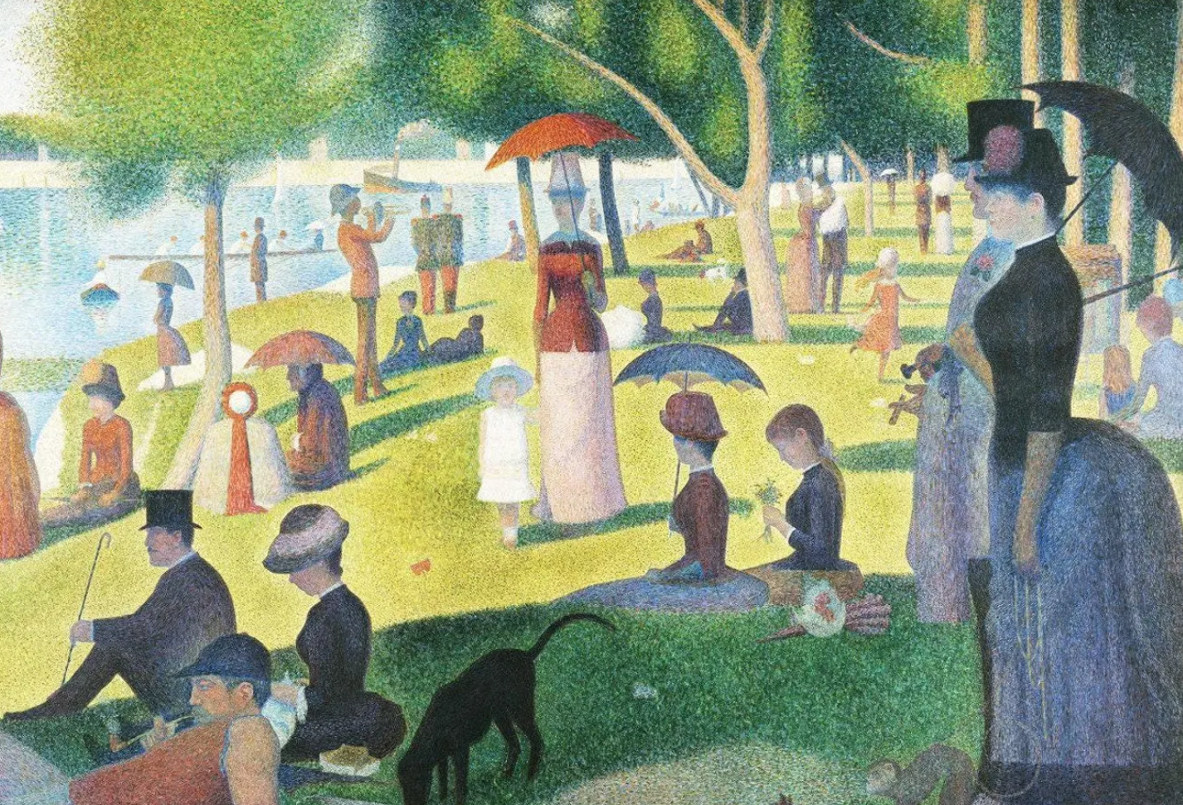
PE:
As well-rounded, active citizens, our children will feel a sense of belonging by immersing themselves in a wide range of physical activities.
This term, our sessions will be guided by an external PE provider and they will take place on Tuesdays.
Forest School:
We are extremely fortunate to be able to access provision for outdoor learning which can increase a child's confidence and self-esteem through exploration, problem solving, and being encouraged to learn how to assess and take appropriate risks depending on their environment. Please ensure children come to school with appropriate clothing and footwear for these sessions.
Art & Design
As artists, the children will be exploring the fascinating world of Georges Seurat, a French painter best known for developing the painting technique called pointillism.
Seurat, created a new way of painting by applying small dots of pure, unmixed colour directly onto the canvas. Rather than blending colours on a palette, Seurat’s technique relies on the viewer’s eye to mix the colours optically, creating a unique and vibrant effect. We will develop our own artwork inspired by a deeper appreciation for how artists can use colour and technique to influence how we experience a painting.
Science:
As scientists, in KS2, children learn about forces as pushes and pulls that can make objects move, stop, speed up, or change shape. They will explore various forces like gravity, friction, air and water resistance, and magnetic forces. They will also investigate how forces are balanced or unbalanced, and how they affect the motion of objects.
Maths:
As mathematicians, Oak class are exploring important measurement concepts and developing their mathematical reasoning skills. Year 3 & 4 are focusing on perimeter, mass, and capacity. Through hands-on activities and real-world examples, they are learning how to measure, compare, and calculate using different units. Year 5 & 6 are building on their previous knowledge by learning about perimeter, area, and volume. As the term progresses, they will also be moving on to fractions, percentages, and decimals.
Music:
As musicians, we will explore the song ‘Keep the home fires burning’ – a ballad from 1914 celebrating the brave service of those at war. We will also learn the song ‘Three Little Birds’ – and the features of the music through listening to classic tracks, singing the song, and adding instrumental riffs and a percussion backing to create a full class performance. We will also have whole class music lessons taught by Mrs Bickel.
Oak Class
Year 3,4,5 & 6
Summer 2025
RHE:
As responsible citizens living in the wider world, we will learn about safety to help children to understand and protect themselves from various risks in their daily lives, both online and offline. This will empower them to make informed decisions, identify hazards, and respond appropriately to dangerous situations, ultimately fostering personal safety and well-being.
History and Geography:
As geographers, this term, we are taking an exciting journey across the globe to learn about China – one of the world’s most fascinating and diverse countries. We will locate China on a map and explore its vast size and different landscapes. We will learn about major geographical features such as the Yangtze River, the Himalayas, and key cities like Beijing and Shanghai and compare life in China to the UK, exploring differences in climate, population, land use, and culture..
As historians, we will be travelling back over 3,000 years to explore one of the earliest recorded civilisations: the Shang Dynasty of Ancient China. We will discover where and when the Shang Dynasty ruled and why it was significant. Learn about daily life in Ancient China, including farming, writing, beliefs, and social structure. We will explore fascinating archaeological finds such as oracle bones and bronze vessels and investigate how we know about the Shang Dynasty and the role of historians and archaeologists.
English:
As writers, we will be focusing on writing to inform. Our main writing outcome will be a non-chronological report, and we will be exploring a variety of informative texts to understand how this type of writing is structured and used in real life. We will study examples of non-chronological reports, learn how to organise and present factual information clearly and build vocabulary and sentence structures suitable for informative writing. To support our writing, we will develop our reading comprehension through our DERIC reading skills, applying these skills while reading our class text, ‘Hansel and Gretel’, answering a range of questions to strengthen our understanding and build connections between reading and writing.
RE:
This term, the children will learn that for Christians, Pentecost marked the beginning of the Church and the outpouring of the Holy Spirit, empowering believers to share the message of Jesus' death and resurrection. It was seen as a fulfilment of Jesus' promise and a catalyst for the spread of Christianity worldwide. We will also explore ideas about how and why religion can help believers when times are hard.
Christian Distinctiveness:
We demonstrate our Christian Values through daily acts of collective worship, singing worship and family group acts of worship.

