Slide 1
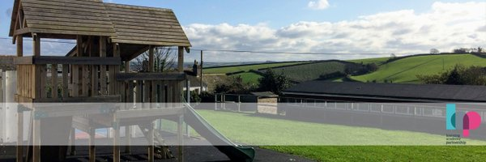
PE:
As well-rounded, active citizens, our children will feel a sense of belonging by immersing themselves in a wide range of physical activities with a focus of athletics, track and field. This term, our sessions will be guided by Premier Sports.
Forest School:
We are extremely fortunate to be able to access provision for outdoor learning. We will be heading off on our adventures again this term! A start date for this will be confirmed shortly.
Please ensure children come to school with appropriate clothing and footwear for these sessions.
Science:
As Scientists, we will be learning all about Plants. We will be growing our own plants to learn what plants need in order to survive. We will be using key scientific skills such as researching, observations over time, identifying, grouping and classifying throughout this unit of learning.
Maths:
As Mathematicians, we will be exploring fractions, time, mass, volume, height and length. Throughout the math’s lessons, we will be applying our knowledge to problems and being able to explain their mathematical knowledge. This term we are placing huge emphasis on the children’s ability to explain, prove and show their answers in another way to develop their mastery of maths. We will also be having daily number sense sessions.
Art & Design: As artists, we will be exploring the work of the Kandinsky. We will be studying his work and discussing how his work can inspire our own. We will learn how to use a variety of tools and recap on our existing knowledge of colour mixing. Like Kandinsky, the children will also have the chance to use music to inspire their movements when painting.
Design & Technology:
As designers, our project this term will be to design, create and evaluate a sandwich for ourselves. During our learning journey we will be learning how to safely cut fruit, how to describe certain tastes and how fruit and vegetables grow.
RE:
To begin, we will be revisiting our topic of Who is a Muslim and exploring how they live. In Summer 2 we will be exploring the question ‘What makes places sacred?’.
Christian Distinctiveness:
We demonstrate our Christian Values through daily acts of collective worship, singing worship and family group acts of worship.
Hazel Class
Year 1 & 2
Summer Term 24-25
RHE:
As healthy, confident and resilient children, we will be learning about citizenship and transition. Throughout the year our learning will be built upon foundations of understanding our emotions, techniques to help us regulate how we are feeling and mindfulness.
English:
During the Summer term, our daily English sessions will be made up of Read Write Inc and handwriting. These sessions are really about embedding and applying the children’s decoding skills and building stamina, so reading becomes second nature. We will also spend more time focusing on developing their comprehensions skills so they can talk about what they have read with confidence and also retrieve answers from the text they have read.
With the lead up to our phonics screening check for our Year 1s we will be really focusing on our fred talk and reading longer words this half term. Summer 2 will have a focus of reading our red words and developing our writing to support all of Hazel classes transition to the higher year group.
History and Geography:
As geographers, will be comparing the UK to Kenya. We will explore the differences in climate, landscapes and weather using a range of resources. They will also be learning about cultural differences and poverty. The children will have a chance to plan their own fundraising event to purchase a gift for a rural Kenyan community through Ripple Effect.
As historians, year 1 and 2 will be delving into the lives of Florence Nightingale and Rosa Parks. We will discover the journey that they went on, and what impact they had at their time and how we live today. We will be using sources and artefacts to support our understanding.
Music:
As musicians, we will be focusing on rock music aiming to perform ‘The rockpool rock’. Throughout the unit the children will listen to a range of rock songs, identifying key characteristics of the style of music and learn about the foundational elements of music. They will also get the chance to learn and use Tamboo Bamboo instruments.

