Slide 1
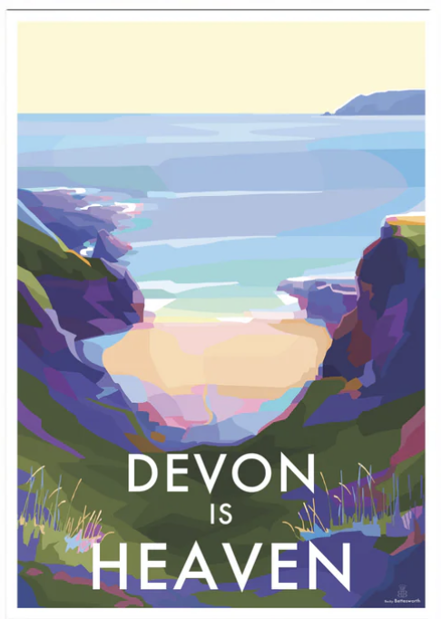
PE:
As well-rounded, active citizens, our children will feel a sense of belonging by immersing themselves in a wide range of physical activities as well as welly walks. This term, our session will be guided by Primary Sports and will be on a Tuesday.
Forest School:
We are extremely fortunate to be able to access provision for outdoor learning. These sessions will take place on Wednesday (see newsletter for class dates).
Please ensure children come to school with appropriate clothing and footwear for these sessions.
Science:
As Scientists, Year 3 & 4 will be learning that animals and humans need nutrition for health and growth and understand the importance of a balanced diet. We will explore the function of skeletons and muscles for support, Year 5 & 6 will build on their understanding of habitats by exploring in greater depth the importance of food, water, shelter and space for survival and reproduction.
Maths:
As Mathematicians, we will be exploring place value, addition & subtraction and shape. To begin, Year 5 & 6 will be: reading, writing and comparing large numbers up to 1,000,000 (Y5) and 10,000,000 (Y6) Year 3 & 4 will be: reading, writing and ordering numbers up to 1,000 (Y3) and 10,000 (Y4).
We will also be practising daily times tables.
Art & Design:
As artists, we will be exploring the work of local artist Becky Bettesworth. Her artistic technique involves creating layered digital illustrations, inspired by 1930s travel posters, using blocks of colour to achieve a graphic, silkscreen-like style. Becky is an acclaimed South Devon artist, beautifully showcasing the charm and nostalgia of the British coast and countryside.
Design & Technology:
As designers, our project this term will be to design, create and evaluate a table lamp. The children will apply their knowledge and understanding of different structures and simple electrical circuits to create their product.
RE:
To begin the term, we will be exploring the importance of creation within the 'Big Story' of the Bible. The children will study Genesis 1 and find out about how different Christians may interpret this text in different ways. We will spend time discussing and weighing up whether Genesis 1 is conflicting or complementary with what science says.
Christian Distinctiveness:
We demonstrate our Christian Values through daily acts of collective worship, singing worship and family group worship.
Oak Class
Year 3,4,5 & 6
Autumn Term
25-26
RHE:
As healthy, safe, responsible and independent individuals, our learning this term will help children to understand the different types of families, the importance of healthy relationships and how to develop positive interactions with family and friends. Our key themes include recognizing what constitutes a healthy relationship, developing communication and respect, understanding different family structures and knowing how to respond to and build positive connections with others.
English:
As writers, our learning will be underpinned by the purpose of writing ‘to entertain’. As a stimulus, we will study the book ‘The Journey’ by Aaron Becker. We will develop our understanding of speech and dialogue skills, placing speech marks correctly around quoted words, using a capital letter for the first word of each new line of dialogue, starting each new speaker on a fresh line and Year 5 & 6 will incorporate reporting clauses into their writing. In class, we will be using our DERIC reading skills to retrieve information and answer questions related to our class novels: Year 5 & 6 ‘Empire’s End – A Roman Story’​ Year 3 & 4 will be reading ‘Escape from Pompeii’.
History and Geography:
As geographers, we will study how humans impact the environment through pollution, deforestation, and habitat destruction, leading to climate change, soil erosion, and a loss of biodiversity. Humans also have the power to positively impact the environment by recycling, growing plants and protecting endangered species.
As historians, we will explore the ancient Roman civilization, their invasion and occupation of Britain starting in 43 AD and their lasting impact. The children will learn about Roman society, their famous roads, villas and baths and how they changed Britain's culture and infrastructure.
Music:
As musicians, we will learn the song ‘Shadows’ by Lindsey Stirling – an American violinist and dancer. As an artist, she creates music that is a fusion of country, electronic dance music (EDM), and rock. The children will learn to identify features of timbre, instrumentation and expression.
We will also be singing traditional Christmas songs alongside new songs in preparation for our Festive Carol Service.

