Slide 1
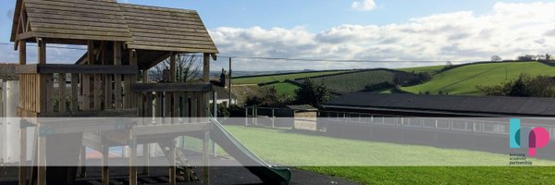
PE:
As well-rounded, active citizens, our children will feel a sense of belonging by immersing themselves in a wide range of physical activities as well as welly walks. This term, our session will be guided by Primary Sports and will be on a Tuesday.
Forest School:
We are extremely fortunate to be able to access provision for outdoor learning. We will be heading off on our adventures this term! A start date for this will be confirmed shortly.
Please ensure children come to school with appropriate clothing and footwear for these sessions.
Science:
As Scientists, we will be learning all about animals including humans. We will classify the different animals and look in depth at a range of features and how our bodies work.We will be using key scientific skills such as researching, observations over time, identifying, grouping and classifying throughout this unit of learning.
Maths:
As Mathematicians, we will be exploring place value, addition & subtraction and shape. Throughout the math’s lessons, we will be applying our knowledge to problems so that the children are able to explain their mathematical thinking. This term we are placing huge emphasis on the children’s ability to explain, prove and show their answers in another way to develop their mastery of maths. We follow the White Rose maths scheme.
Art & Design:
As artists, we will be exploring the work of a local artist, Yvonne Coomber. We will be studying her work and discussing how her work can inspire our own. We will learn how to use paint in a variety of ways using a variety of tools. We will further think about colour mixing and tone.
Design & Technology:
As designers, our project this term will be to design, create and evaluate a book with moving parts.. During our learning journey we will be learning about sliders and levers.
RE:
To begin the term, we will be exploring our question ‘What do Christians believe God is like?" and then recapping the nativity story.
Christian Distinctiveness:
We demonstrate our Christian Values through daily acts of collective worship, singing worship and family group act worship.
Hazel Class
Year 1 & 2
Autumn Term 25-26
RHE:
As healthy, confident and resilient children, we will be learning about citizenship and our economic wellbeing looking at topics such as, caring for others, belonging, looking after money, jobs and people in our community. Throughout the year our learning will be built upon foundations of understanding our emotions, techniques to help us regulate how we are feeling and mindfulness.
English:
During the Autumn term, our daily English sessions will be made up of Read Write Inc and Jane Considine units .These sessions are about embedding and applying the children’s decoding skills and building a stamina for writing, so they become second nature. We will also spend time focusing on developing their comprehensions skills so they can talk about what they have read with confidence an also retrieve answers from the text they have read. Jane Considine units are planned around a specific text and explore different genres of writing.
We will also spend time focusing on our handwriting, using our 4 Ps to ensure that the children feel confident and have the skills to work towards perfect handwriting. We are excited to see who will receive the next KS1 handwriting pencil.
Music:
As musicians, we will learn the menu song. This unit is based around a fun, cumulative song with off-beat rhythms that presents a series of tasty dishes over the course of a week. The children will study musical structures, beats and rhythms.
We will also be exploring traditional Christmas songs along with our new songs that will appear in our Nativity performance.
History and Geography:
As geographers, we will be continuing to consolidate our knowledge of how to look at maps and use them. We will explore our local area, recognise human and physical features and plot these on a map.
As historians, Year 1 and 2 will be looking back to our local history. We will start by consolidating our knowledge of past and present. The children will study resources and interview people to explore changes over time. We will be looking at a variety of things such as themselves, our parents, toys, West Alvington and Christmas. This unit will also give us the chance to look at our own family trees.

